Slide 1


Project 3
SSB (Synchronization Signal Block) Mapping in 5G
Notes:
https://unsplash.com/photos/green-leafed-plants-hckbnUpcm6E

Slide 2
SSB
SSB Structure
Importance of SSB
Table of Contents
SSB Mapping Process
Code
Output

Slide 3

About Project
Our project focuses on the mapping of Synchronization Signal Blocks (SSBs) in 5G NR systems, which are crucial for initial cell search, synchronization, and beamforming. The SSB contains the Primary Synchronization Signal (PSS), Secondary Synchronization Signal (SSS), and Physical Broadcast Channel (PBCH). This project aims to develop a C++ program that simulates the mapping of SSBs onto a time-frequency grid, taking into account various SSB patterns and configurations. Key tasks include understanding the SSB structure, implementing SSB mapping for different numerologies and bandwidths, and validating the implementation against standard SSB burst set patterns. The goal is to gain insights into how SSBs facilitate initial access and beam selection, ensuring accurate and efficient signal mapping in 5G NR networks.
Notes:
https://pixabay.com/photos/lake-cleaner-park-asia-river-7178316/ https://pixabay.com/photos/environmental-protection-nature-3342204/

Slide 4
Group Members
Rajeshwari
Swetav
Sujata
Pavan
Prasad
Shashwat
Bhuvaneshwari
Mentor/Guide:
Abhijeet Kumar
Notes:
https://pixabay.com/photos/lake-cleaner-park-asia-river-7178316/ https://pixabay.com/photos/environmental-protection-nature-3342204/

Slide 5
SYNCHRONIZATION SIGNAL BLOCK (SSB)
Introduction to SSB
(Synchronization Signal Block)
Notes:
https://pixabay.com/photos/lake-cleaner-park-asia-river-7178316/ https://pixabay.com/photos/environmental-protection-nature-3342204/

Slide 6
4.1 of 3GPP 38.213
Synchronization Signal Block
A report setting is then linked to one resource setting for channel measurement and one resource setting for interference measurement.
A resource setting defines which reference signal resources should be used for measurements, what type of reference signal, and the time-domain behavior of the resource configuration, i.e., if it is periodic, semi-persistent, or aperiodic.
Two different types of reference signals are used for CSI acquisition in NR, CSI-RS and the synchronization signal block (SSB).
To enable devices to find a cell when entering a system, as well as to find new cells when moving within the system, a synchronization signal consisting of two parts, the Primary Synchronization Signal (PSS) and the Secondary Synchronization Signal (SSS), is periodically transmitted on the downlink from each NR cell.
The PSS/SSS, together with the Physical Broadcast Channel (PBCH), is jointly referred to as a Synchronization Signal Block or SS block.

Slide 7
SSB (Synchronization Signal Block) Structure
Structure of SSB
(Synchronization Signal Block)
Notes:
https://pixabay.com/photos/lake-cleaner-park-asia-river-7178316/ https://pixabay.com/photos/environmental-protection-nature-3342204/

Slide 8
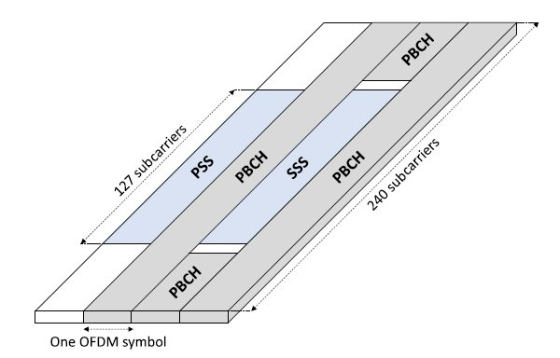
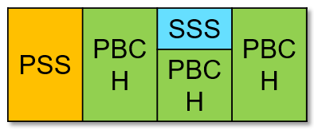
SSB Structure
Fig 2.2 4-Symbol SS/PBCH block
Fig 2.1 Time/frequency structure of a single SS block consisting of PSS, SSS, and PBCH

Slide 9
7.4.3.1 of 3GPP 38.211, 38.213
SSB Structure
The SS block spans four OFDM symbols in the time domain and 240 subcarriers in the frequency domain.
1 OFDM symbol of Primary Synchronization Signal
1 OFDM symbol of Secondary Synchronization Signal
3 OFDM symbols of PBCH
The PSS is transmitted in the first OFDM symbol of the SS block and occupies 127 subcarriers in the frequency domain. The remaining subcarriers are empty.
The SSS is transmitted in the third OFDM symbol of the SS block and occupies the same set of subcarriers as the PSS. There are eight and nine empty subcarriers on each side of the SSS.
The PBCH consists of PBCH payload and PBCH-DMRS placed in second, third and fourth OFDM symbol, and are QPSK modulated.
The length of PBCH is 576 subcarriers, out of which 144 subcarriers are used for PBCH-DMRS. PBCH-DMRS is used for channel estimation by which PBCH payload is equalized and demodulated.
The SS block is used for frame synchronization, carrier frequency offset estimation

Slide 10
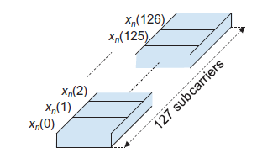
3GPP 38.213
Primary Synchronization Signal (PSS)
PSS is a specific physical layer signal that is used for radio frame synchronization.
The PSS is the first signal that a device entering the system will search for.
Once the device has found the PSS, it has found synchronization up to the periodicity of the PSS. It can then also use transmissions from the network as a reference for its internal frequency generation, thereby to a large extent eliminating any frequency deviation between the device and the network.
PSS extends over 127 resource elements and has 3 different PSS Sequences. Physical cell identity (PCI) of the cell determines which of the three PSS sequences to use in a certain cell.
PSS is used for Downlink Frame Synchronization.
Fig 2.3 PSS Structure

Slide 11
3GPP 38.213
Secondary Synchronization Signal (SSS)
Once a device detects a PSS it knows the transmission timing of the SSS.
By detecting the SSS, the device can determine the PCI of the detected cell.
There are 1008 (3 X 336) different PCIs. However, already from the PSS detection the device has reduced the set of candidate PCIs by a factor 3.
There are thus 336 different SSSs, that together with the already-detected PSS provides the full PCI.
The basic structure of the SSS is same as that of the PSS i.e. the SSS consists of 127 subcarriers to which an SSS sequence is applied.

Slide 12
3GPP 38.213
Physical Broadcast Channel (PBCH)
While the PSS and SSS are physical signals with specific structures, the PBCH is a more conventional physical channel on which explicit channel-coded information is transmitted.
The PBCH carries the master information block (MIB), which contains a small amount of information that the device needs in order to be able to acquire the remaining system information broadcast by the network.
The SS-block time index is provided to the device as two parts:
An implicit part encoded in the scrambling applied to the PBCH.
An explicit part included in the PBCH payload.
Eight different scrambling patterns can be used for the PBCH, allowing for the implicit indication of up to eight different SS-block time indices. This is sufficient for operation below 6 GHz (FR1) where there can be at most eight SS blocks within an SS burst set.
The total number of resource elements used for PBCH transmission per SS block thus equals 576. Note that this includes resource elements for the PBCH itself but also resource elements for the demodulation reference signals (DMRS) needed for coherent demodulation of the PBCH.

Slide 13
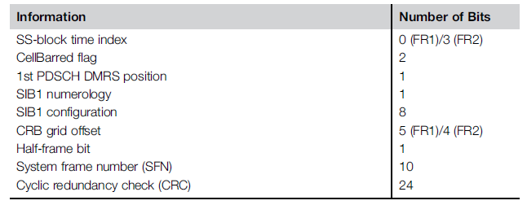
Physical Broadcast Channel (PBCH)
Table 2.1 Information Carried within the PBCH

Slide 14
Importance of SSB (Synchronization Signal Block)
Structure of SSB
(Synchronization Signal Block)
Notes:
https://pixabay.com/photos/lake-cleaner-park-asia-river-7178316/ https://pixabay.com/photos/environmental-protection-nature-3342204/

Slide 15
Importance of SSB
Initial Access and Cell Search - The SSB is crucial for the initial access procedure, which includes the cell search and synchronization phases. When a UE (user equipment) powers on or moves to a new cell, it needs to find and synchronize with a cell to establish a connection.
Time and Frequency Synchronization - For proper communication, UEs need to be synchronized with the network’s timing and frequency. The SSB helps in achieving this synchronization.
System Information Broadcast - The SSB contains essential system information that UEs need to configure their connection with the network.
Beam Management - In 5G NR, beamforming is used to direct signals more precisely. The SSB plays a role in beam management and alignment.
Network Re-selection and Handover - For maintaining continuous service as UEs move between cells, the SSB aids in network re-selection and handover processes.
Support for Multiple UEs and Cells - The SSB supports the efficient operation of multiple UEs and cells within the same coverage area.
Minimizing Latency and Enhancing Reliability - Efficient SSB design helps in minimizing latency and enhancing the reliability of the initial connection setup.

Slide 16
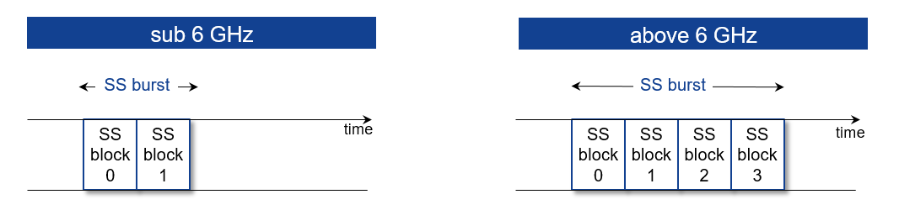
SSB Burst
Synchronization Signal Block Burst (SS Block Burst) is a set of consecutive SS blocks
In 5G18A, there are:
up to 2 blocks in a SS block burst below 6 GHz
up to 4 SS blocks in a SS block burst above 6 GHz
Fig 4.1 No. Of SS Blocks for their respective frequency range

Slide 17
SSB Burst Set
An SSB burst set consists of multiple SS block bursts transmitted across different beams.
The SS-block period is the time between transmissions within a specific beam. This period represents the periodicity of the SS burst set.
For initial access, UE assumes periodicity of 20 ms in both-sub 6GHz, and above 6 GHz
A device in one beam may only detect SS blocks from that particular beam.
The maximum number of SS blocks within an SS burst set is different for different frequency bands.
For frequency range below 3 GHz, there can be up to 4 SS blocks within an SS burst set (L_max = 4), enabling SS-block beam-sweeping over up to four beams;
For frequency bands between 3 GHz to 6 GHz, there can be up to 8 SS blocks within an SS burst set (L_max = 8), enabling beam-sweeping over up to eight beams;
For frequency bands between 6 GHz to 52.6 GHz, there can be up to 64 SS blocks within an SS burst set (L_max = 64), enabling beam-sweeping over up to 64 beams.

Slide 18
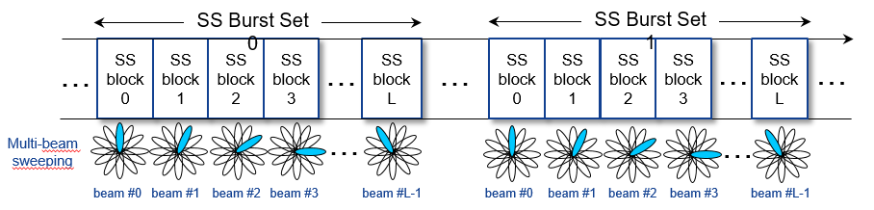
SSB Burst Set
Fig 4.2 Multi-beam Sweeping in SS Burst Sets for Beamforming
Within an SS/PBCH burst set, beams are mapped in consecutive SS/PBCH blocks in increasing order of beam index
The beam indexes are numbered from 0 to L-1 where L represents the maximum number of beams where SS/PBCH blocks are broadcasted within a SS/PBCH burst set
The main purpose of SS Burst sets is to support DL beam sweeping, in which DL Tx beams are sequentially transmitted in order to cover the whole service area in one SS Burst Set

Slide 19
SSB Mapping Process
Notes:
https://pixabay.com/photos/lake-cleaner-park-asia-river-7178316/ https://pixabay.com/photos/environmental-protection-nature-3342204/

Slide 20
SSB Mapping in Time Domain
7.4.3.1 of 3GPP 38.211, 38.213
SSB Periodicity
Periodicity: The SSBs are transmitted at regular intervals, known as SSB periodicity. This can be configured to values such as 5 ms, 10 ms, or 20 ms. The choice of periodicity depends on the network configuration and requirements.
Time Intervals: For example, if the SSB periodicity is 10 ms, then an SSB is transmitted every 10 ms, and therefore, it appears once every 10 ms in the radio frame.
Slot Allocation
Slot Mapping: The SSB is mapped to specific slots within the radio frame. The exact slot(s) in which an SSB is transmitted is determined by the gNodeB’s configuration. The mapping needs to ensure that the SSB is consistently transmitted at known intervals for the UE to detect and synchronize.
SSB Transmission: Within a specific slot, the SSB might occupy a particular portion of the slot. This allocation is typically done in a manner that allows UEs to reliably detect the SSB across different slots and frames.
Subframe and Slot Structure
SSB in Slots: Given that a slot is 0.5 ms long, an SSB occupies a part of a slot. Each slot can contain multiple SSBs, but this depends on the configuration and the bandwidth of the carrier.
Synchronization: The SSB provides synchronization information necessary for the UE to lock onto the base station’s signal. This involves detecting the SSB's specific time slot and periodicity.

Slide 21
7.4.3.1 of 3GPP 38.211, 38.213
SSB Mapping in Frequency Domain
Frequency Grid
Resource Blocks (RBs): The frequency spectrum in 5G NR is divided into Resource Blocks (RBs), each spanning 180 kHz. The RBs are the smallest units of frequency allocation.
Carrier Bandwidth: The total bandwidth of a carrier is made up of multiple RBs. For example, a 10 MHz carrier comprises approximately 50 RBs.
SSB Resource Elements
Resource Elements: An SSB is spread across a set of resource elements within the allocated RBs. The resource elements are the intersection of frequency (RBs) and time (OFDM symbols).
Physical Broadcast Channel (PBCH): The PBCH carries essential system information and is part of the SSB.
Synchronization Signal: The SSB also includes synchronization signals like the Primary Synchronization Signal (PSS) and Secondary Synchronization Signal (SSS), which are essential for time and frequency synchronization.
Frequency Offset and Patterns
Frequency Offset: The SSB is transmitted with a specific frequency offset relative to the carrier frequency. This ensures that the SSB can be detected across different parts of the spectrum.
Frequency Patterns: The mapping of the SSB to specific RBs and frequency offsets is designed to ensure coverage and detectability. The exact pattern of frequency allocation can vary depending on the carrier configuration and bandwidth.

Slide 22
Code
Notes:
https://pixabay.com/photos/lake-cleaner-park-asia-river-7178316/ https://pixabay.com/photos/environmental-protection-nature-3342204/

Slide 23
Code
Source: GitHub, LinkedIn

Slide 24
Output
Notes:
https://pixabay.com/photos/lake-cleaner-park-asia-river-7178316/ https://pixabay.com/photos/environmental-protection-nature-3342204/

Slide 25
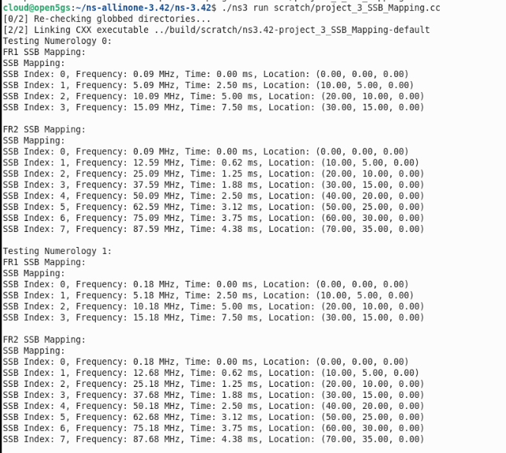
Output

Slide 26
Thank You!
Notes:
https://unsplash.com/photos/green-leafed-plant-gCvxfc_Gmrg

